Slide 1
Managing Devices
Identify the Types of Linux Devices
Configure Devices
Monitor Devices
Troubleshoot Hardware Issues

Slide 2

Topic A: Identify the Types of Linux Devices
Exam Objectives:
2.7 Explain the use and operation of Linux devices.

Slide 3
The Importance of Device Drivers
Drivers are an interface between OS and device.
Crucial for devices to function in Linux.
Great strides have been made to write Linux-compatible drivers.
May still be compatibility issues in certain cases.
No matter the device, make sure:
Device drivers are available.
Your system has those drivers.
Without drivers, the device may function poorly or not at all.

Slide 4
Thin Clients (Slide 1 of 2)
Lightweight computing devices that connect to more powerful servers for doing work.
Server does heavy lifting (processing, storage, etc.).
Thin client is little more than a user interface.
This architecture centralizes and streamlines operations.
Linux has robust remote connection support.
Thin client can have I/O devices connected.
Thin client can run a lightweight distro with restrictions.
Server can create virtual environment for client to work in.
Both client and server may be Linux, or only one, or neither.

Slide 5
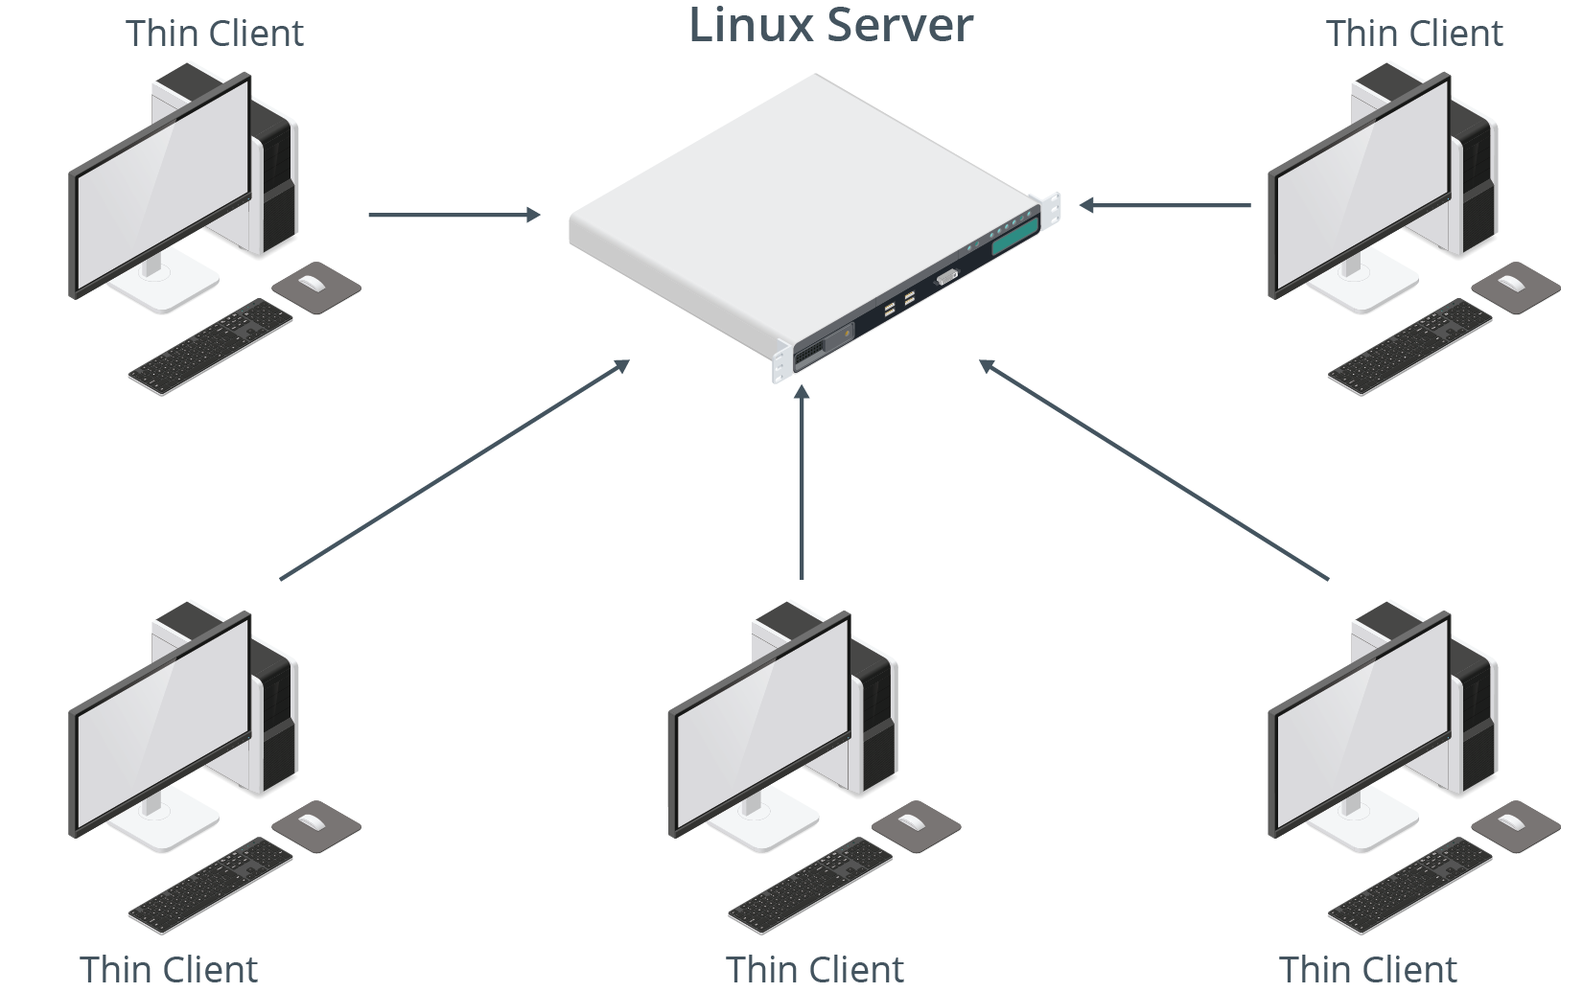
Thin Clients (Slide 2 of 2)

Slide 6
USB Devices
The de facto standard interface technology used to connect peripheral devices to computers.
Also incorporates plug-and-play features.
Some supported types:
Thumb drives
External HDDs/SSDs
Digital cameras
Smartphones/tablets
Printers/scanners
Keyboards/mice
Microphones/webcams
Game controllers

Slide 7
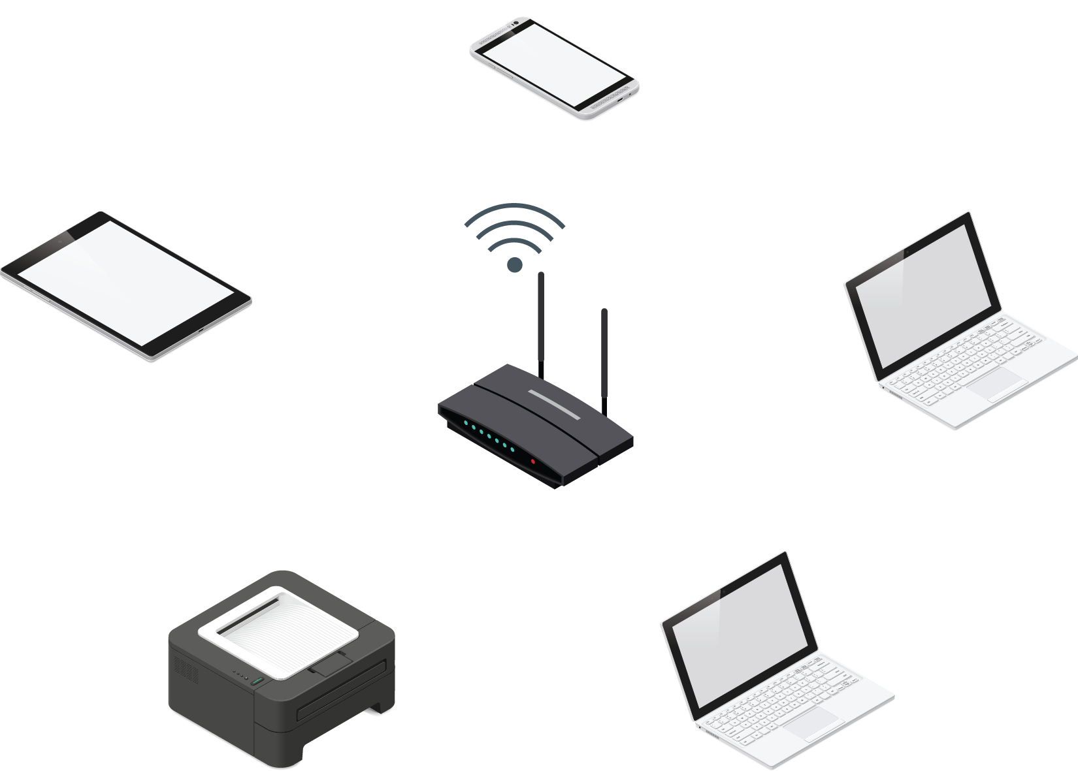
Wireless Devices
Transmit/receive signals over the air.
Common protocols:
Wi-Fi
Bluetooth
NFC

Slide 8
Video and Audio Devices
I/O peripherals usually attached to client systems.
Video input: webcams, surveillance cameras, digital cameras.
Video output: monitors, televisions, projectors.
Audio input: microphones, some video input devices.
Audio output: speakers, headphones, some video output devices.
Connection types are important.
Microphones/webcams use USB.
USB not reliable for streaming audio/video output.
Monitors use HDMI/DisplayPort to carry both video and audio.
Older monitors use DVI/VGA to carry video only.

Slide 9
Printers
Linux supports printers and printing software.
Support is dependent on available drivers and quality of drivers.
Has improved over the years.
Use multiple connection methods.
USB for physical connection.
Wi-Fi and/or Ethernet adapter for network connection.
Popular in offices; multiple clients connect to same printer.
Linux computers can act as print management servers.

Slide 10
Network Adapters
A device that provides an interface with which hosts exchange data over a network.
Required for a computer to access any network.
Often built into motherboard.
Some can be added to expansion buses.
Some can be connected externally through USB.
System can have more than one.
Common on servers and security systems.
Each connection protocol requires its own adapter.

Slide 11
GPIO (Slide 1 of 2)
Pins on a circuit board that have no designated purpose, but are controllable at runtime.
Pins send and receive digital signals.
Examples:
Output pin can turn LED light on/off.
Input pin can be turned on/off by external light switch.
Controlled programmatically through software.
Developer can design app to interact with outside world.
Found on single-board microcontrollers (Arduino, Raspberry Pi).
Can be used in IoT space.
Raspbian and other distros can control GPIO through programming libraries.

Slide 12
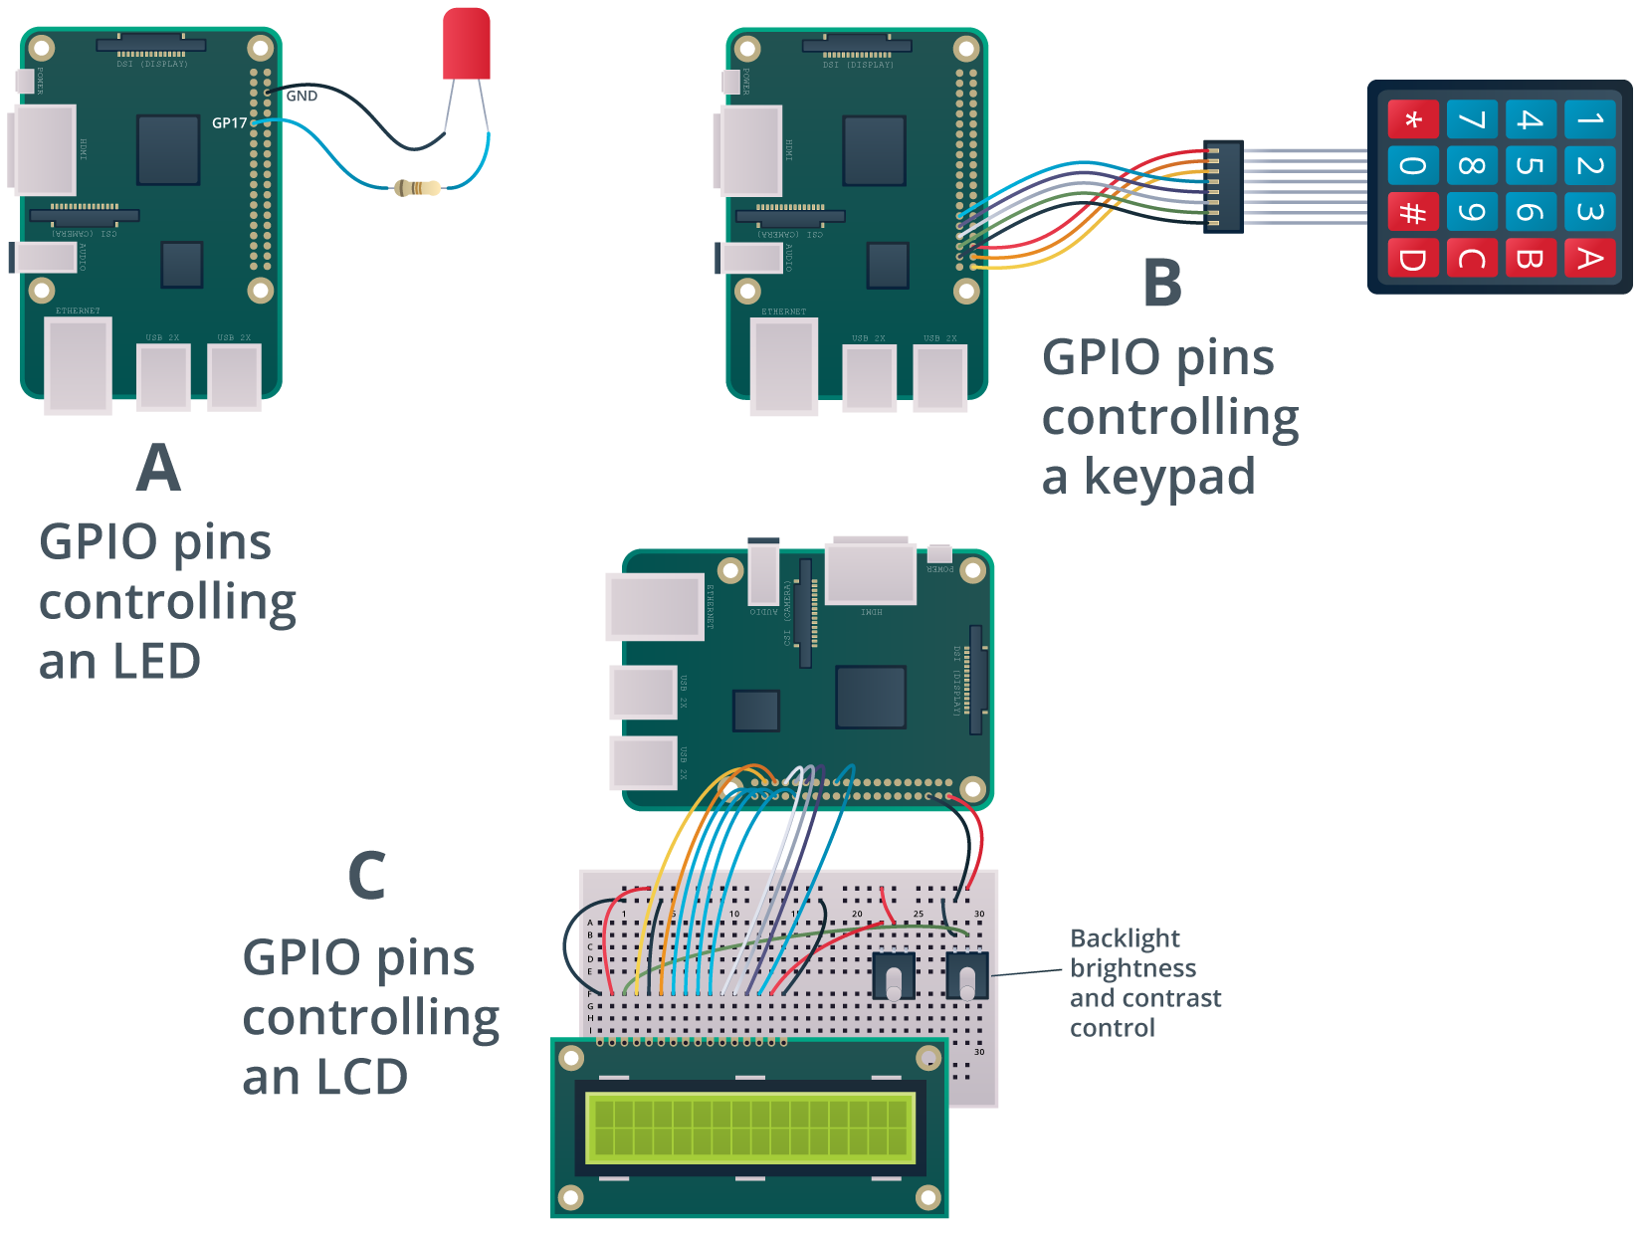
GPIO (Slide 2 of 2)

Slide 13
SATA
A computer bus interface standard for attaching storage devices to traditional computers.
Largely replace PATA/IDE in PCs.
Offers high capacity and low cost.
Older versions have lower transfer rates.
Less suitable for enterprise storage.
Used for backups and consumer storage.
Current revision (3.2) is up to 16 Gb/s.
Combines SATA with PCIe.
Standard SATA (3.1) is up to 6 Gb/s.

Slide 14
SCSI
A computer bus interface for connecting peripheral devices to traditional computers.
SATA used for storage; SCSI used for storage and peripheral devices.
Use in storage is more common.
Traditional SCSI uses a parallel interface.
More costly than serial.
Provided high transfer rates in the past.
Was popular for enterprise storage.
SAS applies serial technology to SCSI.
Much faster (up to 24 Gb/s in SAS-4).
Supports higher capacities.
More reliable.
Now the go-to for enterprise storage.

Slide 15
HBA
A hardware component that connects a host system to a storage device in order to facilitate the input and output of data.
Is to storage devices what NICs are to networks.
Used with interfaces like SATA, SCSI, etc.
Built into motherboard or as a separate expansion card.
You connect storage device to HBA.
Enables system to work with device.

Slide 16
PCI
A connection interface standard that is primarily used as an expansion bus for attaching peripheral devices.
Superseded by PCIe.
Greater transfer speeds.
More reliable error detection.
Smaller size.
Dominant expansion bus technology.
PCIe used for video cards, expansion cards, etc.
PCIe also used for connecting NVMe SSDs.
Even faster than SSDs in SATA/SAS.
Will become more prominent in enterprise storage.

Slide 17
Activity: Identifying the Types of Linux Devices
You need to configure/maintain devices for clients/servers.
You need to apply this to Linux environments.
First, ensure you know the common devices and how they connect.

Slide 18
Topic B: Configure Devices
Exam Objectives:
2.7 Explain the use and operation of Linux devices.

Slide 19
Device File Locations
Location | Description
/proc/ | Files representing info reported by kernel. /proc/devices lists all character/block devices.
/sys/ | Creates hierarchical view of device info. /sys/devices/ includes files that expose device details.
/dev/ | Device driver files. Example: Mount block device through /dev/sda1 /dev/mapper includes LVs, encrypted devices, etc.
/etc/ | Config files for many components. /etc/X11/ has files for configuring I/O devices impacting X.Org Server.
Notes:
Teaching Tip: Students should be familiar with most of these locations. Use this as an opportunity for review.

Slide 20
Hotpluggable Devices
Devices that can be physically added or removed from the system without requiring a reboot.
Detected by system when plugged in.
Coldpluggable devices are not; require a complete reboot.
RAM, CPUs, internal storage, etc.
Some coldpluggable devices require system to be powered off.
Modern distros support hotplugging for many bus types.
USB, FireWire, PCIe, etc.

Slide 21
udev
A device manager that automatically detects and configures hardware devices.
A function of systemd.
Initialized during boot.
Handles configuration for both hotpluggable/coldpluggable devices.
Loads coldpluggable modules when system is booted.
Loads hotpluggable modules dynamically during runtime.

Slide 22
udev Rules
Add rules files in /etc/udev/rules.d/
Rules tell udev to configure device/run command when plugged in.
Example: Create symbolic link on device plugin.
You always can refer to device in the same way.
Don't have to rely on /dev/sda1, /dev/sdb2, etc.
Refer to device by unique attributes (e.g., vendor/product ID).
Example rule:
KERNEL=="sd*", ATTRS{idVendor}=="334455", ATTRS{idProduct}=="667788", SYMLINK+="myusb"
Name file in format ##-name.rules

Slide 23
The udevadm Command (Slide 1 of 2)
Manages udev to modify runtime behavior.
Subcommand | Used To
info | Retrieve device info/attributes stored in udev database or /sys/
control | Modify running state of udev.
trigger | Execute rules that apply to plugged-in devices.
monitor | Watch for events sent by kernel or udev rule.
test | Simulate udev event running for a device.

Slide 24
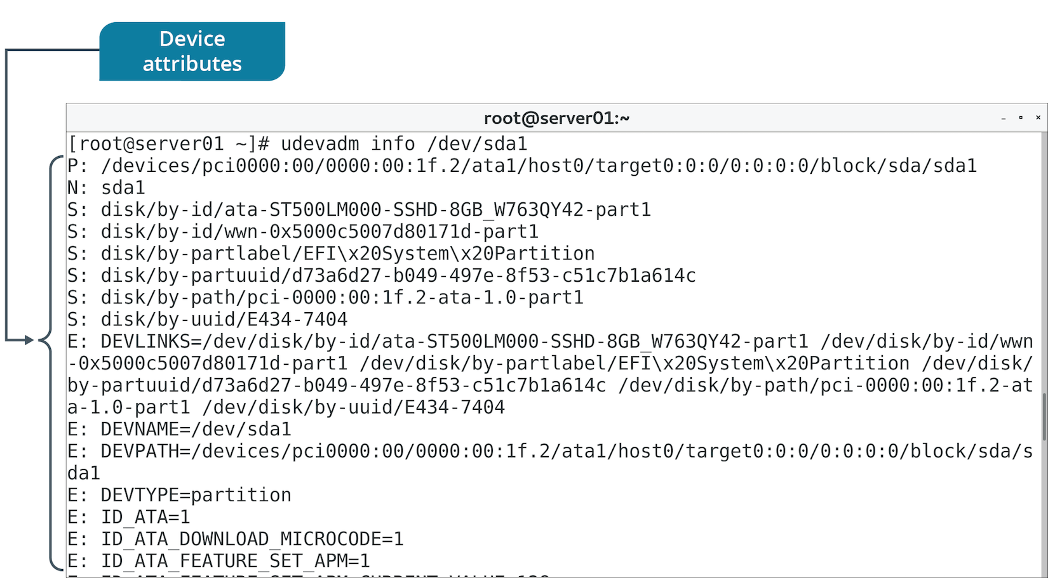
The udevadm Command (Slide 2 of 2)

Slide 25
Printing Software
Printers are usually bundled with software utilities.
Enable you to configure printer settings.
May only run on specific OSs.
You can still use Linux utilities.
Vendors usually provide drivers for download on their websites.

Slide 26
CUPS (Slide 1 of 2)
A print management system for Linux that enables a computer to function as a print server.
System running CUPS can initiate print jobs from clients.
Jobs are processed and sent to appropriate printer.
Can process different data formats on same print server.
Designed for:
Scheduling jobs.
Processing admin commands.
Providing printer status.
Has web-based interface for configuration.
Modifies /etc/cups/cupsd.conf and /etc/cups/cups-files.conf

Slide 27
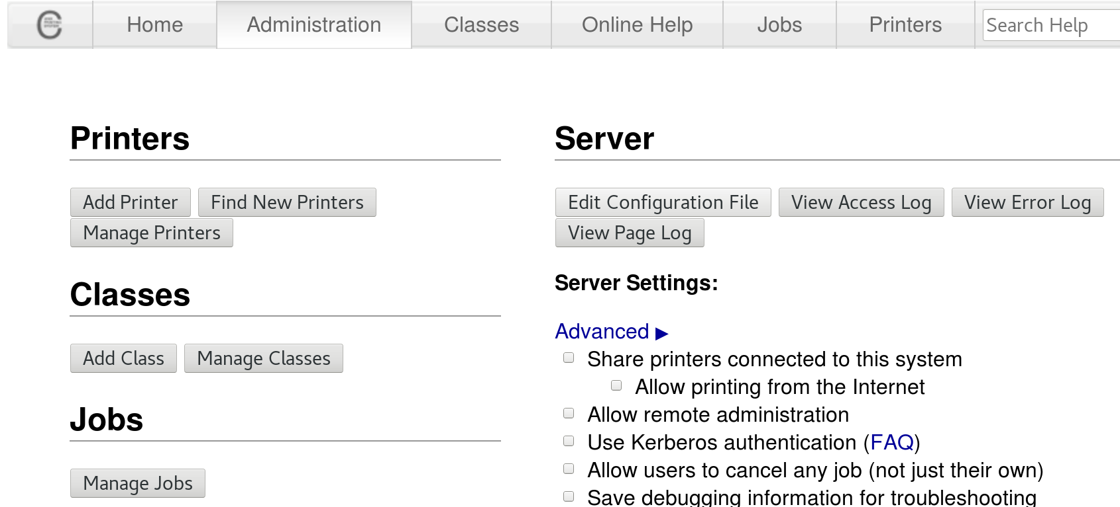
CUPS (Slide 2 of 2)

Slide 28
The lpr Command
Submits files for printing.
Files are sent to specified printer or job queue.
If no printer is specified, default printer is used.
Configurable through CUPS.
Reads print file from stdin if no files are supplied.

Slide 29
Discussing Configuring Devices

Slide 30
Activity 9-2: Discussing Configuring Devices
What task can you perform to be able to refer to a device with the same custom name every time it is plugged in?
ANSWER:
Create a symbolic link to the device through a udev rule in /etc/udev/rules.d/

Slide 31
Activity 9-2: Discussing Configuring Devices
What is the significance of udev?
ANSWER:
Prior to systemd and new kernels, the /dev/ directory only contained static device files—udev brings dynamic device creation and removal.

Slide 32
Activity 9-2: Discussing Configuring Devices
How can you start the CUPS service?
ANSWER:
systemctl start cups

Slide 33
Activity 9-2: Discussing Configuring Devices
How do you send the file students.txt to the HPLJ5 printer?
ANSWER:
lpr -P HPLJ5 students.txt

Slide 34
Activity 9-2: Discussing Configuring Devices
There are two device types recognized by the udev device management system: coldpluggable and hotpluggable. When does the system load modules for each device type?
ANSWER:
Coldpluggable device modules are loaded at boot and hotpluggable device modules are loaded dynamically by the kernel when a new device is plugged in during normal operation.

Slide 35
Activity: (Optional) Using udev to Manage a Hotpluggable Device
A colleague preps installation media on a USB drive.
System assigns non-descriptive name to drive.
She wants to reference the drive using a more helpful name.
You'll use udev to create a symbolic link to the drive.
Will activate every time the drive is plugged in.
Will be based on device's unique attributes.
Notes:
Teaching Tip: Consider demoing this activity yourself if not enough students have USB thumb drives they can use, or if you want to save time.

Slide 36
Activity: Configuring a Virtual (PDF) Printer
HR wants to distribute AUP to employees.
Will use both hardcopy and electronic.
Right now, you don't have a real printer set up.
You can still print to a PDF for electronic distribution.
You'll need to set up a virtual printer first.
Notes:
Teaching Tip: Students will learn more about package management with yum and other tools in a later lesson.

Slide 37
Topic C: Monitor Devices
Exam Objectives:
2.7 Explain the use and operation of Linux devices.

Slide 38
The lsdev Command
Displays info about system hardware.
Compiles info from:
/proc/interrupts
/proc/ioports
/proc/dma

Slide 39
The lsusb Command (Slide 1 of 2)
Displays info about devices connected to USB.
Scans /dev/bus/usb/ directory.
Prints number of bus/device, device ID, and vendor/product.
Use -v flag to see more detail about each device.
Filter results by bus (-s) and vendor/product (-d).

Slide 40
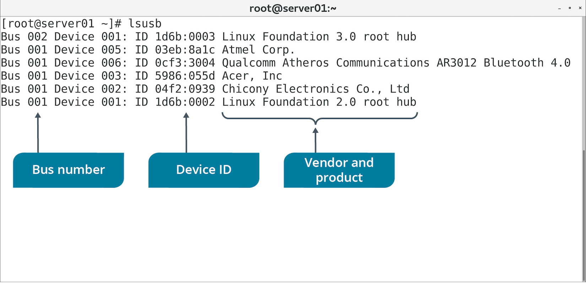
The lsusb Command (Slide 2 of 2)

Slide 41
The lspci Command (Slide 1 of 2)
Displays info about devices connected to PCI bus.
Lists logical slot address, device class, and vendor/product.
Includes verbose option for more details about devices.

Slide 42
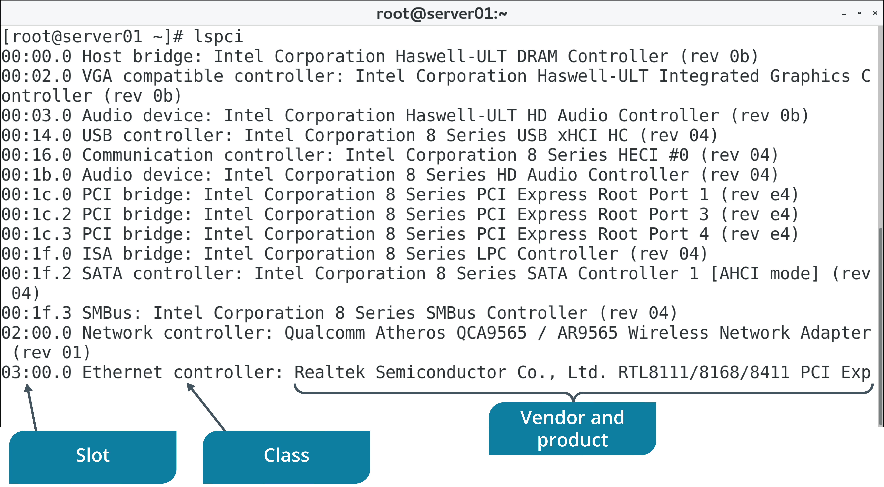
The lspci Command (Slide 2 of 2)

Slide 43
The lpq Command (Slide 1 of 2)
Shows status of printer queue.
Reports for each job:
The job's rank.
Who owns the job.
The name of the files in the job.
The size of the job.
Use +interval to update report every specified number of seconds.
Will use default printer if none specified.

Slide 44
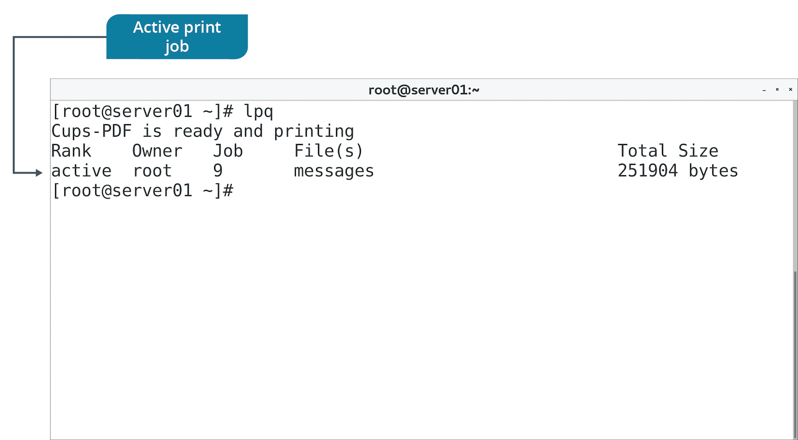
The lpq Command (Slide 2 of 2)

Slide 45
Additional Device Monitoring Tools
Some tools you've used before can also be useful in monitoring devices.
Example: lsblk
Identify block storage devices.
Ensure devices are recognized.
Ensure devices are correctly partitioned/mounted.
Example: dmesg
Show device driver messages sent to kernel.
Can include errors in operation or module loading failures.
Monitor for issues related to drivers or underlying hardware.

Slide 46
Discussing Monitoring Devices

Slide 47
Activity 9-5: Discussing Monitoring Devices
You want to check the print queue before you attempt to reboot the system. How do you check the print queue for the non-default printer, HPLJ5?
ANSWER:
lpq -P HPLJ5

Slide 48
Activity 9-5: Discussing Monitoring Devices
What does the lpq -a command display?
ANSWER:
It displays print jobs on all configured printers.

Slide 49
Activity 9-5: Discussing Monitoring Devices
What does the lsusb command display?
ANSWER:
lsusb displays all USB buses and a list of USB-attached devices and the buses they're connected to. The list will likely be different for every system.

Slide 50
Activity 9-5: Discussing Monitoring Devices
Which command can you use to display information about all block devices and how can you find out more information about each device in the list?
ANSWER:
Use lsblk to list all block devices and their parent devices. Use udevadm info to display specific information about each device. The dmesg command also provides some device details.

Slide 51
Activity 9-5: Discussing Monitoring Devices
From where does the lsdev command pull its displayed information?
ANSWER:
It draws its information from the /proc/interrupts, /proc/ioports, and /proc/dma files.

Slide 52
Activity: Monitoring Devices
You need to track devices used on all computers in network.
You need to maintain a list of hardware resources in use.
Notes:
Interaction Opportunity: Encourage students to share their findings with the class.
Teaching Tip: Students may not see USB device results in a virtual environment if no USB drivers are loaded.

Slide 53
Topic D: Troubleshoot Hardware Issues
Exam Objectives:
2.7 Explain the use and operation of Linux devices.
4.4 Given a scenario, analyze and troubleshoot application and hardware issues.

Slide 54
Common Hardware Issues
Common sources of problems:
Missing or poorly configured drivers.
Incompatible user space software.
There are many other potential sources.
And many other potential solutions.
Issue categories:
Keyboard mapping
Communications port
Printer
Memory
Video
Storage adapter

Slide 55
Keyboard Mapping Issues
Certain keys may produce unexpected results when pressed.
Common symptom of keyboard mapping issues.
Wrong keyboard layout/language may be configured.
Start by identifying the layout of the actual keyboard.
Layouts differ based on overall design and language/region.
Use localectl status to see what layout is configured.
If it's wrong, find the correct one, then set it.
May need to adjust system language as well.

Slide 56
Communications Port Issues
Ports may fail to recognize attached devices.
Connection may be unreliable.
Ensure:
Device is slotted into port.
Cables are undamaged/not loose.
HBA is powered.
Device supports correct bus version.
Also install/load necessary drivers.
Certain serial devices will request a console interface to Linux.
Usually assigns /dev/ttyS#
Ensure device is configured to access these consoles.
Only root can access them by default; may need to change permissions.

Slide 57
Printer Issues
A very common source of issues.
Printer itself might be at fault.
Consult the help manual/manufacturer's site.
Ensure your printer has compatible drivers and that they're loaded.
Use network diagnostic tools if you can't connect to a networked printer.
A printer with too much load might be unresponsive.
Multiple users try to print at once.
Use lpq to check job status.
Use lprm {job #} to stop large or numerous jobs.
Clearing up queue lightens the load on the printer.

Slide 58
Memory Issues
Memory can leak.
Process fails to free up memory when done with it.
Memory is exhausted.
Performance degrades.
Use memory/process monitoring tools to identify problem.
Address offending process as necessary.
Some issues are with the physical RAM.
"Machine Check Exception" errors during operation.
mcelog retrieves error messages.
ECC errors indicate RAM failure.
Use memory testing tools to stress test RAM.

Slide 59
Video Issues
Common issues:
Blank screens
Wrong colors
Multiple monitors not detected
Sluggish performance
Ensure display devices are connected properly and are compatible.
GPU driver support has been less robust than on Windows.
Has improved in recent times.
Make sure you have the latest drivers.
Ensures optimal video performance.
Download from vendor's website.

Slide 60
Storage Adapter Issues
Symptoms:
Poor data transfer speeds.
Reduced capacity.
Read/write errors or complete failures.
Devices not detected.
Ensure HBA is powered.
Ensure HBA uses appropriate interface.
Older versions may not offer expected performance.
Ensure devices are slotted and cables are connected.
Rescan a SCSI bus if new device isn't detected:
echo "- - -" > /sys/class/scsi_host/host#/scan
Can be disruptive.

Slide 61
The lshw Command (Slide 1 of 2)
Lists each detected hardware component and details.
Pulls details from multiple device file locations.
Outputs vendors, product names, specifications, and more.
Motherboard, CPU, RAM, peripherals, storage, etc.
Use to identify if device is recognized by kernel.
Use to review device's capabilities.

Slide 62
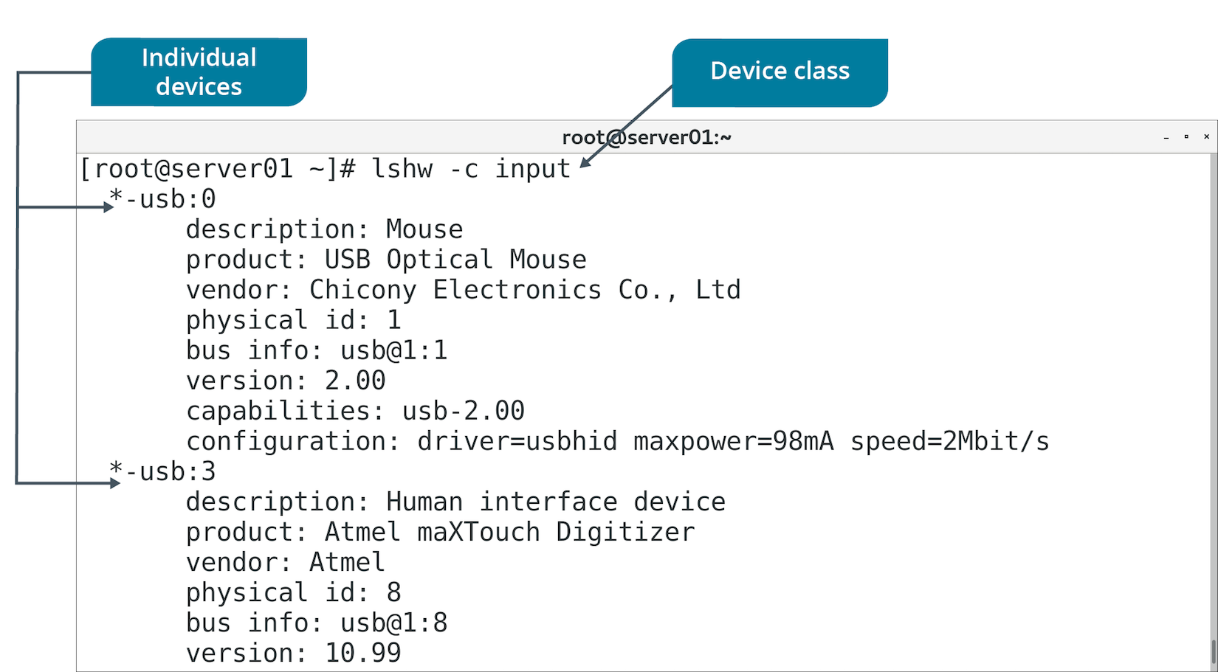
The lshw Command (Slide 2 of 2)

Slide 63
The dmidecode Command
Dumps DMI table and presents it in human-readable format.
DMI table is an industry standard for tracking hardware.
Separates hardware into types.
Verify if devices are connected and their supported features.
DMI tables are often inaccurate or incomplete.
Don't rely on them as sole source of info.

Slide 64
ABRT
A utility that analyzes and reports on problems detected during system runtime.
Primarily for Fedora- and RHEL-based distros.
Collects data like memory dumps from crashed apps.
Helps diagnose and troubleshoot problems.
Can report on hardware device problems like MCEs.
Can redirect problem data to multiple destinations.
Issue trackers, local files, remote files, etc.
Default location for problem data is /var/spool/abrt

Slide 65
Guidelines for Troubleshooting Hardware Issues
Ensure devices are supported by drivers.
Ensure drivers are installed and loaded.
Ensure hardware devices are compatible with Linux software.
Verify system has correct keyboard layout/language.
Verify that network printer is identifiable on the network.
Use lprm to stop problematic print jobs.
Check mcelog for memory errors.
Run a memory testing utility if you suspect RAM failure.
Download latest GPU drivers.
Ensure devices are properly slotted into correct buses.
Ensure cables are not loose or damaged.
Use lshw to identify hardware on the system.
Be aware dmidecode may be inaccurate.
Review crash data compiled by ABRT.

Slide 66
Activity: Troubleshooting Hardware Issues
Your systems fulfill many purposes, and interface with many kinds of hardware.
You need to troubleshoot inevitable hardware issues.

Slide 67
Activity 9-7: Troubleshooting Hardware Issues
What is a common source of problems with keyboards, printers, and storage adapters?
ANSWER:
Missing or poorly configured drivers are a common source of hardware problems.

Slide 68
Activity 9-7: Troubleshooting Hardware Issues
What is the term used to describe the situation where a process fails to free up allocated memory when it is no longer needed?
ANSWER:
This is referred to as a memory leak.

Slide 69
Activity 9-7: Troubleshooting Hardware Issues
What are two common hardware-related issues that are not a result of faulty drivers or insufficient memory?
ANSWER:
Loose or damaged cables and improperly slotted or plugged devices.

Slide 70
Activity 9-7: Troubleshooting Hardware Issues
Which of the following commands is an often unreliable way of querying the system for attached hardware components?
ANSWER:
lshw
vmstat
free
dmidecode

Slide 71
Activity 9-7: Troubleshooting Hardware Issues
Which of the following connection protocols may lshw not detect?
ANSWER:
USB
FireWire
SCSI
PCI

Slide 72
Activity 9-7: Troubleshooting Hardware Issues
A user is complaining that their USB mouse is unresponsive. Which of the following commands can you can use to quickly pull up information about the device, including its vendor, product model, and drivers?
ANSWER:
lshw -c input
lshw -c mouse
dmidecode -t input
dmidecode -t mouse

Slide 73
Activity 9-7: Troubleshooting Hardware Issues
When a user presses the Shift+2 on their keyboard, they expect the @ symbol to be entered, but instead, the # symbol is. What can you do to troubleshoot this issue?
ANSWER:
Answers may vary, but the most useful approach to take is to examine the language and keyboard mapping settings on the computer. It's likely that the wrong keyboard format is set—to another language, region, or keyboard style—causing unexpected characters to be entered upon certain keystrokes.

Slide 74
Activity 9-7: Troubleshooting Hardware Issues
Several users have been issuing multiple print jobs to the printer, causing it to become backed up and unresponsive. You enter the lpq command to query the print jobs, and notice that one job is very large and likely causing the bottleneck. Which of the following commands should you enter to stop the offending print job and free up the queue?
ANSWER:
lpq -s {job number }
lprm {job number}
lpq -s {print file name}
lprm {print file name}

Slide 75
Activity 9-7: Troubleshooting Hardware Issues
You recently installed a new graphics card in one of your Linux systems that will be used by Develetech's video editor. The video editor notices sluggish performance and repeated crashes in their video editing software. You've deduced that the software isn't the source of the problem; the graphics card is. What step(s) should you take to try to solve this problem?
ANSWER:
Answers may vary, but when it comes to graphics card issues, one of the most important troubleshooting steps is to ensure that you always download the latest drivers available from the manufacturer. These drivers often fix performance and stability issues, especially when the graphics card is put to use by video-intensive software.

Slide 76
Activity 9-7: Troubleshooting Hardware Issues
An administrator has reported that a Linux server is sluggish, unresponsive, and frequently triggers a kernel panic with the error message "Machine Check Exception". What can you do to diagnose and fix this issue?
ANSWER:
Answers may vary, but this particular error usually indicates faulty hardware. You can redirect the exact error code into the mcelog command to get more information about the error. Since the system is sluggish and unresponsive, you might see an error-correcting code (ECC) error, indicating that one of the memory modules has failed. You can then run a program like memtester to stress test your RAM modules.

Slide 77
Activity 9-7: Troubleshooting Hardware Issues
One of Develetech's software developers has been programming on a Raspberry Pi device. He's been trying to connect the Pi's serial cable to a Linux system so that he can see the output of the program on the Linux console. However, the output doesn't appear. What can you do to troubleshoot this issue?
ANSWER:
Answers will vary. You should perform standard steps like ensuring the correct drivers are installed, checking the physical cables for damage and to see if they're properly slotted into the serial port, etc. If this doesn't resolve the problem, you should make sure that the serial device is using the expected serial console, typically located at /dev/ttyS# where # is the number of the console (starting with 0). You may need to configure the Pi's settings so that it uses this console by default. Also, by default, only the root user is allowed to access serial ports. If necessary, use chmod to grant access to /dev/ttyS# for the appropriate accounts.

Slide 78
What type of storage and peripheral bus interface(s) do you use in your organization, or do you expect to use?
What are the most common hardware issues that you or your colleagues experience in the workplace?

